Slide 1

Cars Price Prediction Project
K. Rahul Ramanujam

Slide 2

Problem Statement: With the covid 19 impact in the market, we have seen lot of changes in the car market. Now some cars are in demand hence making them costly and some are not in demand hence cheaper. One of our clients works with small traders, who sell used cars. With the change in market due to covid 19 impact, our client is facing problems with their previous car price valuation machine learning models. So, they are looking for new machine learning models from new data.
The problem statement is pretty self-explanatory:
The model have to be built in such a way that it predicts the pricing when the respective features are given as inputs.

Slide 3

Data Collection Phase: You have to scrape at least 5000 used cars data. You can scrape more data as well, it’s up to you. More the data better the model In this section You need to scrape the data of used cars from websites (Olx, cardekho, Cars24 etc.) You need web scraping for this. You have to fetch data for different locations. The number of columns for data doesn’t have limit, it’s up to you and your creativity. Generally, these columns areBrand, model, variant, manufacturing year, driven kilometers, fuel, number of owners, location andat last target variable Price of the car. This data is to give you a hint about important variables in used car model. You can make changes to it, you can add or you can remove some columns, it completely depends on the website from which you are fetching the data.
→ I have scraped the data from the Cars24 website with the help of selenium. Around 8.5K rows of data has been scraped, it helps in better modelling.

Slide 4

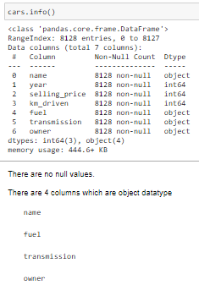
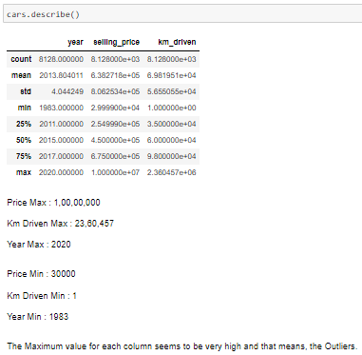
1) Data Cleaning: This phase of the project involves the data to undergo stages like getting rid of null values, outliers, extra info (symbols) and make it EDA ready.
From the above snips, it is clear that there are no missing values. But there are outliers, they cannot b compromised since they influence the final selling price big time.

Slide 5
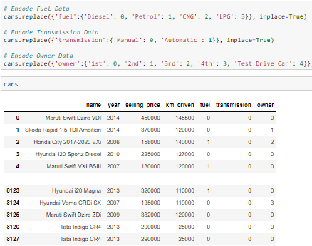
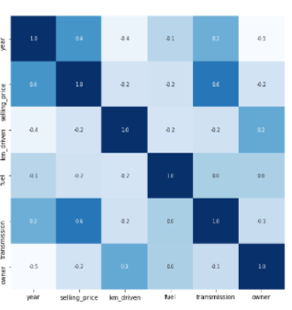
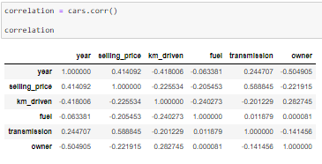
2) EDA: This stage involves how the data is explored and analysed to draw better inferences and understand the data better.
All three snips are the analysis of the data where it shows how the categorical values are assigned with numbers, how correlation is shown and plotted for a better understanding.

Slide 6
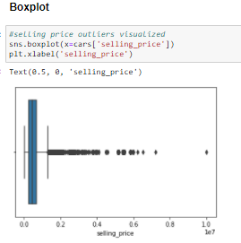
3) Visualization: The data is now ready with no missing values or other extra factors. We can plot the data to draw better inferences out of those and understand how the features are impacting the final selling price.
i) Uni-Variate Analysis: Boxplot
The plot shows the outliers presence but they cannot be compromised as they represent the final selling price big time.

Slide 7
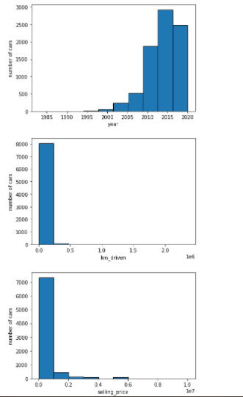
Histogram:
The plots show impact on the number of cars being sold. For example, we’ve taken ‘int’ datatype features like:
i) Year and No.of cars
ii) Kms driven and No.of cars
iii) Selling price and No.of cars
Those plots show us how impactful the features can be towards the final selling price of cars.
The aim of the project is to build a proper model to predict price and these feature values are given as input to predict the right pricing,

Slide 8
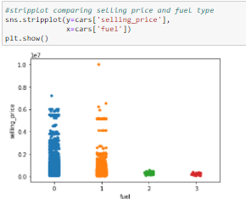
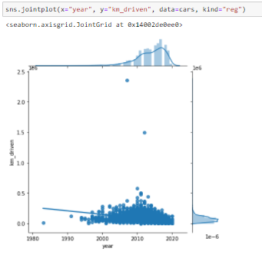
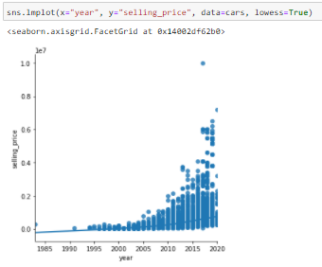
Bi-Variate Analysis: The analysis done by using two features at a time and see how they are proportional/relate to each other. This will help in understanding the data better. It is proven that the features are quite impactful towards the final pricing but let us see how they impact each other.
The plots include: selling price vs year, selling price vs fuel and kms_driven vs Year.
All those plots signifies one thing in common, I.e. They are impacting each other well and this will help in understanding how to go further with this info for a better modelling.

Slide 9
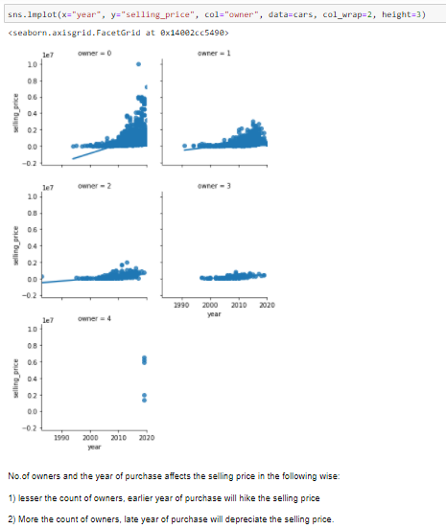
Tri-Variate Analysis: There are 3 features are taken at a time to see they each impact each other.
The relationship among the features like:
1) Year
2) Selling_price
3) owner
The plot is clear enough to draw the inferences like:
lesser the count of owners, earlier year of purchase will hike the selling price
2) More the count of owners, late year of purchase will depreciate the selling price.
The basic mentality of any customer is to go for a car which is as good as possible with lesser kms driven, year of purchase and lesser previous owners.

Slide 10
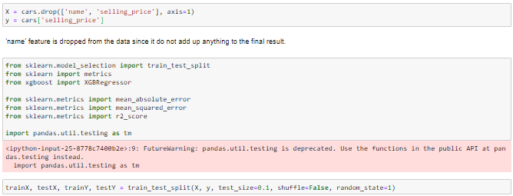
4) Data Pre-Processing: The data is just one step away from the model building stage. We make the data ready in this phase by splitting it and giving the necessary changes to it.

Slide 11
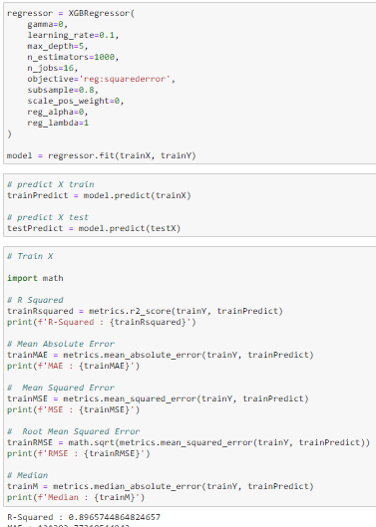
5) Model Building: Whatever that we’ve done till now to the data is for this stage, we build the models by using the data, train it, parameters are used, finally prediction is done. The model which gives the best accuracy score is retained and saved.
XGBRegressor:
The model is given with necessary inputs such as learning_rate, max_depth and other hyperparameters to make it more aggressive in giving the better performance.
n_estimators = no.of trees. (1000 is chosen as the data is huge)
max_depth = Depth of each tree. (5 is given to increase each tree’s grasping capacity)
objective = the aim of the model. (softmax is used since it’s a multi-classification problem)
nthread = Number of cores being utilized. (4 is given, 6 or 8 can also be given according to the machine capacity)
The XBBoost ensemble has always been a dependable to the data scientists for yielding the best possible results.
The r2 square we got is 0.89

Slide 12
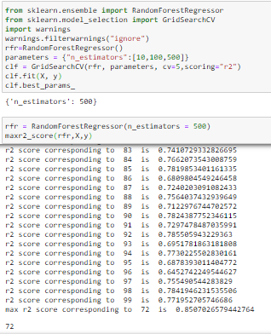
2) Random Forest Regressor:
The best possible random_state is 72
And
R2 score achieved is 0.85
RFR model has always been reliable
Since they are second best after
XGBoost in yielding better results.

Slide 13
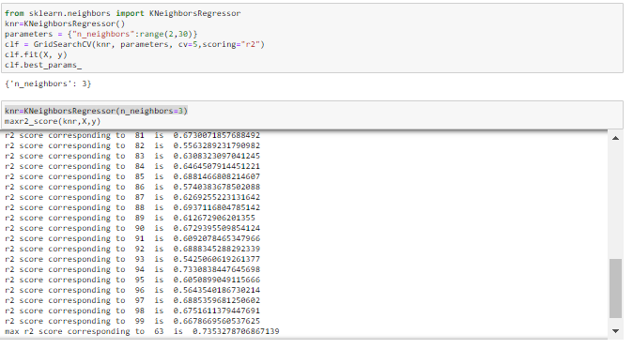
KNR:
Using GridSearchCV, the best possible parameters are used to get the r2 score of 0.73

Slide 14
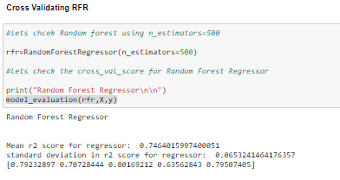
Out of all the models that were tested, Random Forest Regressor has the r2 score.
The Cross Validation is applied for all the models and the best possible score was found from RFR, thus, we’ll save this model as a final model to get better predictions.
**The model is ready for the client to use and predict the rating out of their old review texts.**
Thank you

